Slide 1
Bliss Cruise 2016
Castaways Travel

Slide 2
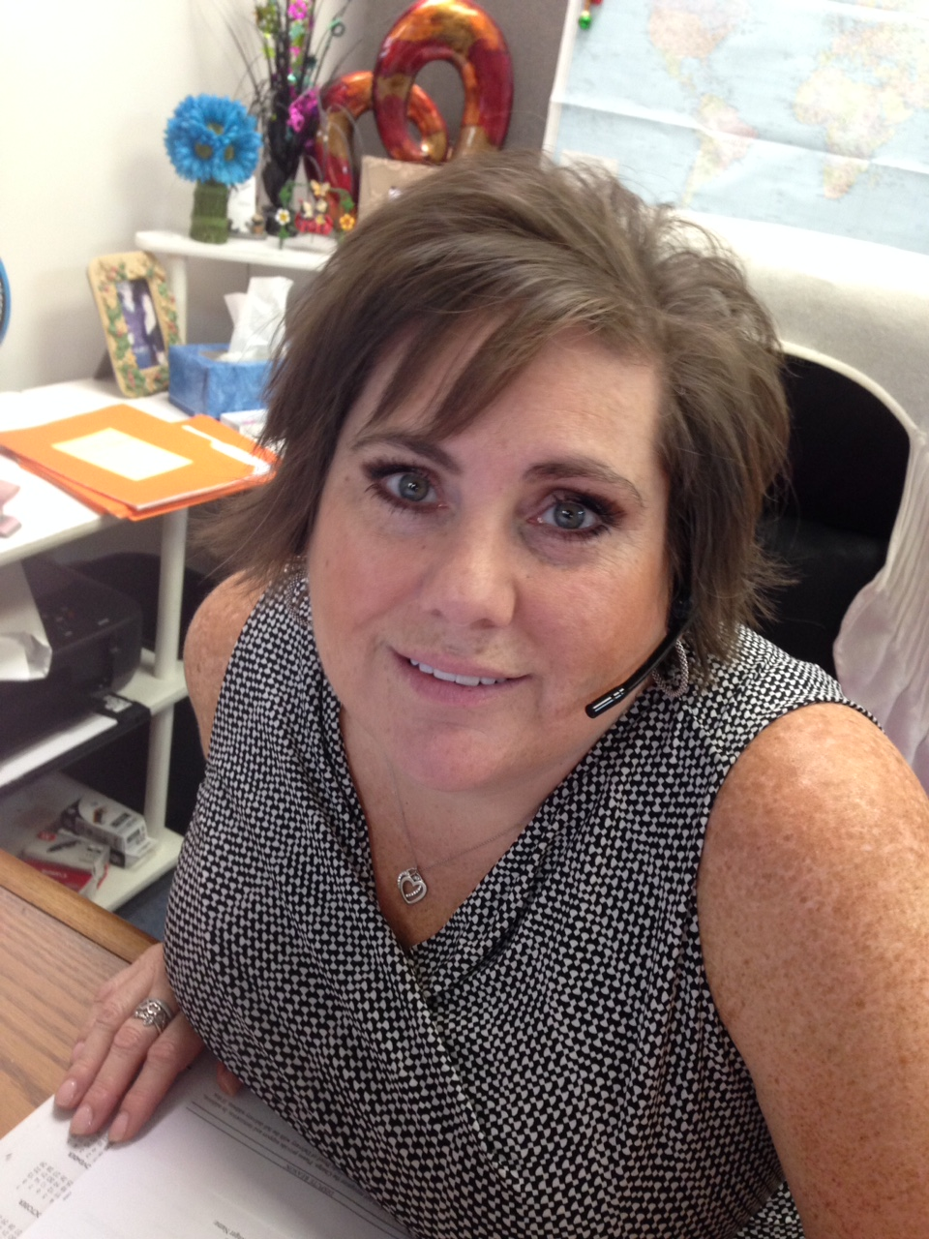
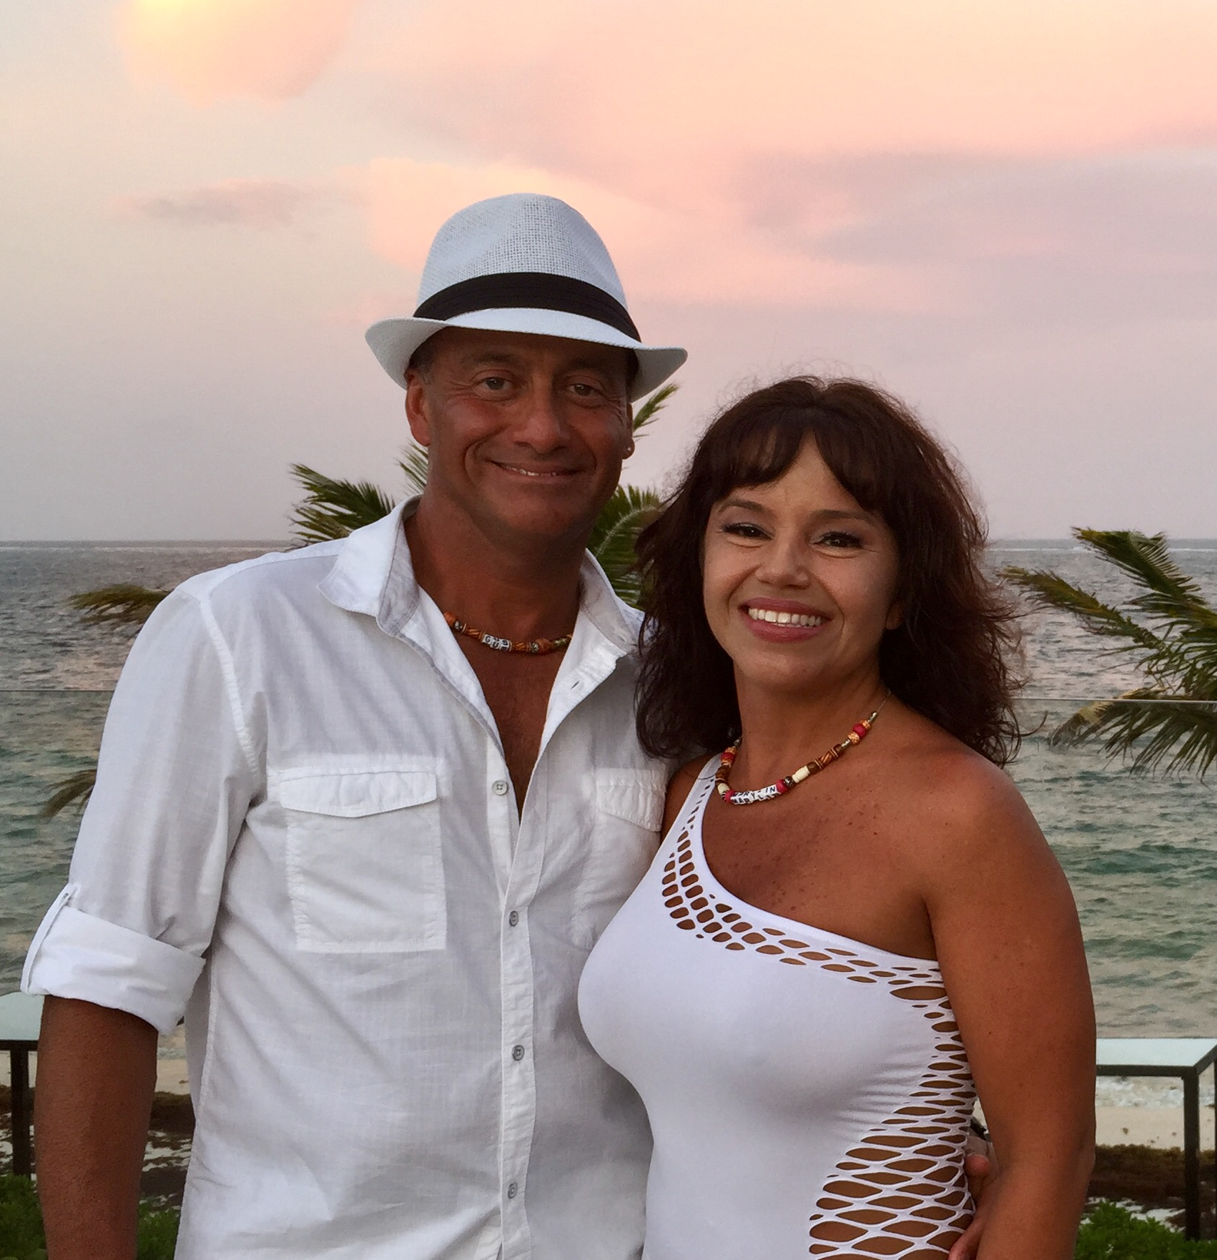
Your Hosts
James and Champagne
Jennifer
Gus and Marylin
James Cell Phone 281-660-4190

Slide 3
Welcome to Bliss Cruise 2016
The goal of this webinar is to make sure you have the most fun possible!
This webinar is being recorded and is available for download in the morning
A copy of the nude cruising eBook and the cruising checklist will also be available.

Slide 4
A Brief Agenda
Cruise Itinerary
Cruise Special Events
Theme Nights
Passport Reminder
Credit Cards
Top Cruise Tips
Questions and Answers

Slide 5
Itinerary
Sunday November 27, 2016 – Ft. Lauderdale, Florida – 4 PM Dock
Monday November 28, 2016 – At Sea
Tuesday November 29, 2016 – San Juan, Puerto Rico – 3 PM – 9:30 PM Dock
Wednesday November 30, 2016 – St. Croix, USVI – 8 AM – 5 PM Dock
Thursday December 1, 2016 – St. Maarten – 8 AM – 5 PM Dock
Friday December 2, 2016 – At Sea
Saturday December 3, 2016 – At Sea
Sunday December 4, 2016 – Ft. Lauderdale, Florida – 7 AM Dock
* All itineraries are subject to change without notice.

Slide 6
Special Events Subject to change, check your official program
Castaways Official Meet & Greet Day 2 Monday, November 28 From 4-5 PM - FREE Cruise Drawing, Must Be Present to Win. Drinks (beer, wine, rum punch), snacks, music & Fun Sky Observation Lounge. Deck 14 Forward Castaways clients only, Come as you are...shorts, swim suits, whatever Pick up your name necklaces from Dave & Debbie
Champagne's Newcomers Questions & Answers Day 1 Sunday November 27 4:30 PM Quasar Lounge Deck 4 Forward
Daily Meet & Greet Cash Bar – "Champagne’s Martini Bar"/Crush Come as you are. 6 PM - 7 PM Visit "Champagne's Martini Bar" - Cash Bar Deck 4 Mid ship (excludes Day 1 and San Juan stop) Sign up for your next Bliss Cruise with Jennifer & Marylin from Castaways Travel
Castaways Private Luncheon* to Thank You - Castaways clients only 12 Noon to 2 PM (Wine included) Tuscan Grill Deck 5 Aft Come as you are, wear a shirt/no swimsuits - Capacity limited RSVP Required Day 2 Monday November 28 RSVP required Win a Prize Tuscan Grille, Deck 5, Aft Day 6 Friday, December 2 RSVP required Win a Prize Tuscan Grille, Deck 5, Aft *Invited guests only. Please no visitors. NOTE: You will receive an invitation and RSVP reminder in your cabin's mail slot.
Castaways Pool Party Day 7 Saturday December 3 2 - 4 PM Pool Deck Get Nekkkid! Win some prizes
Castaways Story (video) View the story of Castaways Travel on your Bliss Cruise Channel in your stateroom
NOTE: Times/Locations subject to last minute changes. Check the Daily Newsletter delivered the evening before the issue date

Slide 7
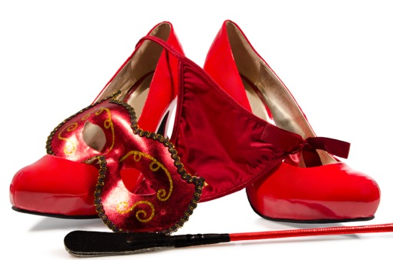
Theme Nights
White Night: From “tighty whities” boxers and briefs, to white suits and swimsuits, to tuxedos and tails. It’s your chance to get creative.
Red Carpet Glamor Night (Dress Up): Get the red carpet ready for our formal night. Celebrate like the Hollywood stars do and experience the glitz and glamour.
Animal Kingdom Party: Be the party animal that you are in your favorite animal print.
Glow Rave Night (Pool Party): Wow, the most successful deck party from last year is back. “Anything Glows” in this up-all-night extravaganza.
Superhero vs. Villains (Pool Party): Time to choose your poison: Wonder Woman, Man of Steel, Minions, Terminator or Transformer, Dracula or Cruella de Vil — there’s lots to choose from.
Freaky Friday: Get your freak on and show off your wild side.
Pajama Slumber Party: What have you dreamed about in bed lately? Or, “who” have you been thinking about in your bed lately? Break out your teddies and favorite bed time stories for a night of fantasies.

Slide 8
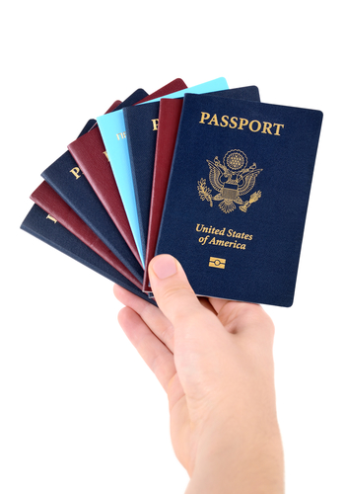
Passports
Don’t forget your passport or proof of citizenship (birth certificate and government issued photo ID)
Please remember your passport
Take a photo with your phone of all your Important documentation
Make copies of these documents, place a copy in your luggage and leave a copy with friends

Slide 9
Charging Things
CHARGE ACCOUNTS At the cruise terminal, an imprint of your credit card will be taken for your on board expenses. Then, you will be given your Cruise Card which is like a credit card which it is...and it's also your cabin door key. You will not need money on board, just your cruise card to charge all of your purchases to your account.
CHARGE CARDS Call your charge card company now to notify them you may have transactions outside the country so your credit card charges won't be disapproved while your husband is buying you a diamond ring.

Slide 10
Top Cruise Tips
DINING Open seating at restaurants. Main restaurant evening meal: 6 PM - 10 PM Times subject to change. Reservations NOT required and no set times. Exception: Specialty Restaurants require reservations and a meal surcharge applies. Tuscan Grille, Qsine, Murano's, Blu, Lawn Club Grill
DOOR DECORATIONS Be creative and add something fun to your cabin door facing the hallway, fun photos, decorations, etc.
DRINK PACKAGE Buy your drink package online or once you board the ship. NOTE: A service charge will be added to each bar bill or drink package. It's usually automatically included in the bill you sign. Terms & Cost subject to change.
EXTRA CLOTHES/SWIMSUIT Take an extra change of clothes in your carry on luggage when you board the ship. Wear or take some comfortable, tropical clothes plus a swim suit to change into when you reach your cabin. Before you board the ship, you will hand over your baggage curbside to be delivered to your cabin. Tag your luggage so it gets delivered properly. Baggage delivery requires several hours.
FLIGHTS & BOARDING PASS Before you head to the airport from home, re-confirm your flights for correct flight time, flight number changes, seat assignments and frequent flier accounts. Print boarding passes or post in your iPad or iPhone.

Slide 11
More Cruise Tips
INTERNET You can buy the service on board after you arrive. Price varies with minutes purchased. Check with Guest Services for rates/package.
LIFEBOAT DRILL Mandatory lifeboat drill will be conducted before the ship departs Ft. Lauderdale Sunday afternoon. Proceed from you cabin to the meeting area designated on your life jacket in your cabin or ask a crew member.
LUGGAGE TAGS If you have not printed luggage tags from the Celebrity site, don't worry: Plenty of them are available at the dock curbside when you arrive.
MEET & GREET You will receive your invitation on board. Castaways Meet & Greet is: Come as you are. Attend to have a chance to win a door prize and meet your other cruisers and Castaways' host couples on board.
SHORE EXCURSIONS Can be arranged on board, subject to capacity restrictions. See Guest services/Shore Excursions Desk, both on Deck # 3 Mid ship. Once you board the ship, go directly to the Shore Excursions to order your tickets.
SPA Make your appointments as soon as you get on board. Sea days fill up fast.

Slide 12
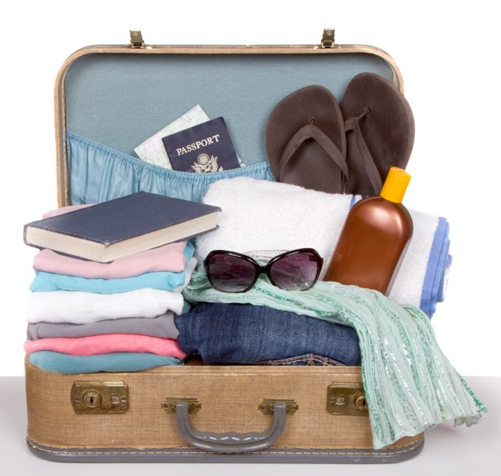
Things to Bring
POWER BAR for more electrical outlets
Compact Umbrella
Extra Hangers
Money
PASSPORTS and Travel Documents
Download our eBook and check out what to pack

Slide 13
Future Bliss Cruises
2017 Bliss Cruise Celebrity SUMMIT - March 20-25, 2017 Ft. Lauderdale to Progreso, Mexico & Cozumel – From $625/person + tax Couples Only , clothing optional
2017 Bliss Cruise Celebrity Equinox - November 25-December 2, 2017 Miami, Ponce (P.R.), St. Thomas, St. Kitts – From $950/person + tax Couples Only, clothing optional
2018 Bliss Cruise RCL Freedom of the Seas - November 4-10, 2018 This fabulous ship IS a Destination itself! From Ft. Lauderdale with 3 full days at sea included plus ports of call: Falmouth, Jamaica and Cozumel, Mexico – From $875/person + tax/tips/port charges. Couples Only, clothing optional Book early for best value as cabin rates increase as ships sell out.

Slide 14
Questions
?
Thank you submitting your questions!

Slide 15
Can I take wine on board?
Yes, 2 - 750 ML bottles per cabin

Slide 16
Where can I use the beverage package:
Use this link to see the Celebrity FAQs
http://www.celebritycruises.com/frequently-asked-questions#faq5994

Slide 17
Are ATMs on board?
Yes Also currency exchange at Guest Services

Slide 18
Are DVDs in Cabins?
No

Slide 19
Movies On Demand?
Yes, cost extra

Slide 20
What are the cabin cabin amenities in each stateroom?
http://www.celebritycruises.com/onboard-celebrity/staterooms http://www.celebritycruises.com/frequently-asked-questions#faq5993
These two Celebrity FAQs explain this in detail.
http://www.celebritycruises.com/onboard-celebrity/staterooms
http://www.celebritycruises.com/frequently-asked-questions#faq5993

Slide 21
White Night: What to wear, gals?
Lingerie or evening wear while dining? Change into lingerie after dining.

Slide 22
Nude shore excursions? St Maarten?
No group visit permitted for Orient Beach
The locals do not want mass tourism on their beach

Slide 23
24 Hour coffee?
Oceanview Cafe or 24-hour room service

Slide 24
Do cabins have steam irons?
No, but laundry, pressing and dry cleaning service is available on board

Slide 25
Dining after partying late at night/early morning?
Oceanview Cafe - Aft Re-opens late Midnight to 4 AM
(Hours are estimated)

Slide 26
How about the Zika virus?
Please use this link to learn more http://www.celebritycruises.com/frequently-asked-questions#faq5994

Slide 27
Can I still pre-purchase shore excursions on line with Celebrity?
Yes – Jennifer can fill us in a bit more

Slide 28
Numerous Internet Questions:
Long explanation....covered in FAQ section:
http://www.celebritycruises.com/frequently-asked-questions
According to the Celebrity Reservations office: Silhouette includes the Xcelerate package. Questions? Call 800-647-2251

Slide 29
How can our friends/relatives contact us on the ship for an urgent phone call?
(877) 266-1020 Friends or family can reach you 24 hours a day via Celebrity's Satellite Service. Your friends and family can contact the ship by calling (877) 266-1020. From outside the U.S., they can call (732) 335-3296.

Slide 30
What is Dress Code for the Bliss Cruise?
There is no "Official" Dress Code. A few things to keep in mind. Main Dining Room: Club Wear is recommend, Most guest dress to impress. Pasties are welcomed with sheer or gauze covering the pasties. If no underwear, a towel will be provided at the entrance to the dining rooms.
No bare feet in any dining rooms. Most guests change into themed costumes after dinner with the exception of "White Night" Nudity: Nudity is only allowed on outside decks, playrooms, and the sauna.
You cannot go nude in any elevator, you must be covered.
Topless is permitted once inside the discos.. No nudity permitted while in any port of call, unless instructed by the ship's captain, even if you are on your own balcony.
For the party rooms you must be dressed to enter, even with just a robe. You disrobe inside the party room.

Slide 31
What happens during the cruise?
This Celebrity FAQ tells you more:
http://www.celebritycruises.com/frequently-asked-questions#faq5993

Slide 32
Other questions? Use the Celebrity Cruise FAQs
Or, give us a call at Castaways Travel 800 470-2020
http://www.celebritycruises.com/frequently-asked-questions

Slide 33
Download tonight’s presentation
http://castawaystravel.com/bliss2016/

